Slide 1
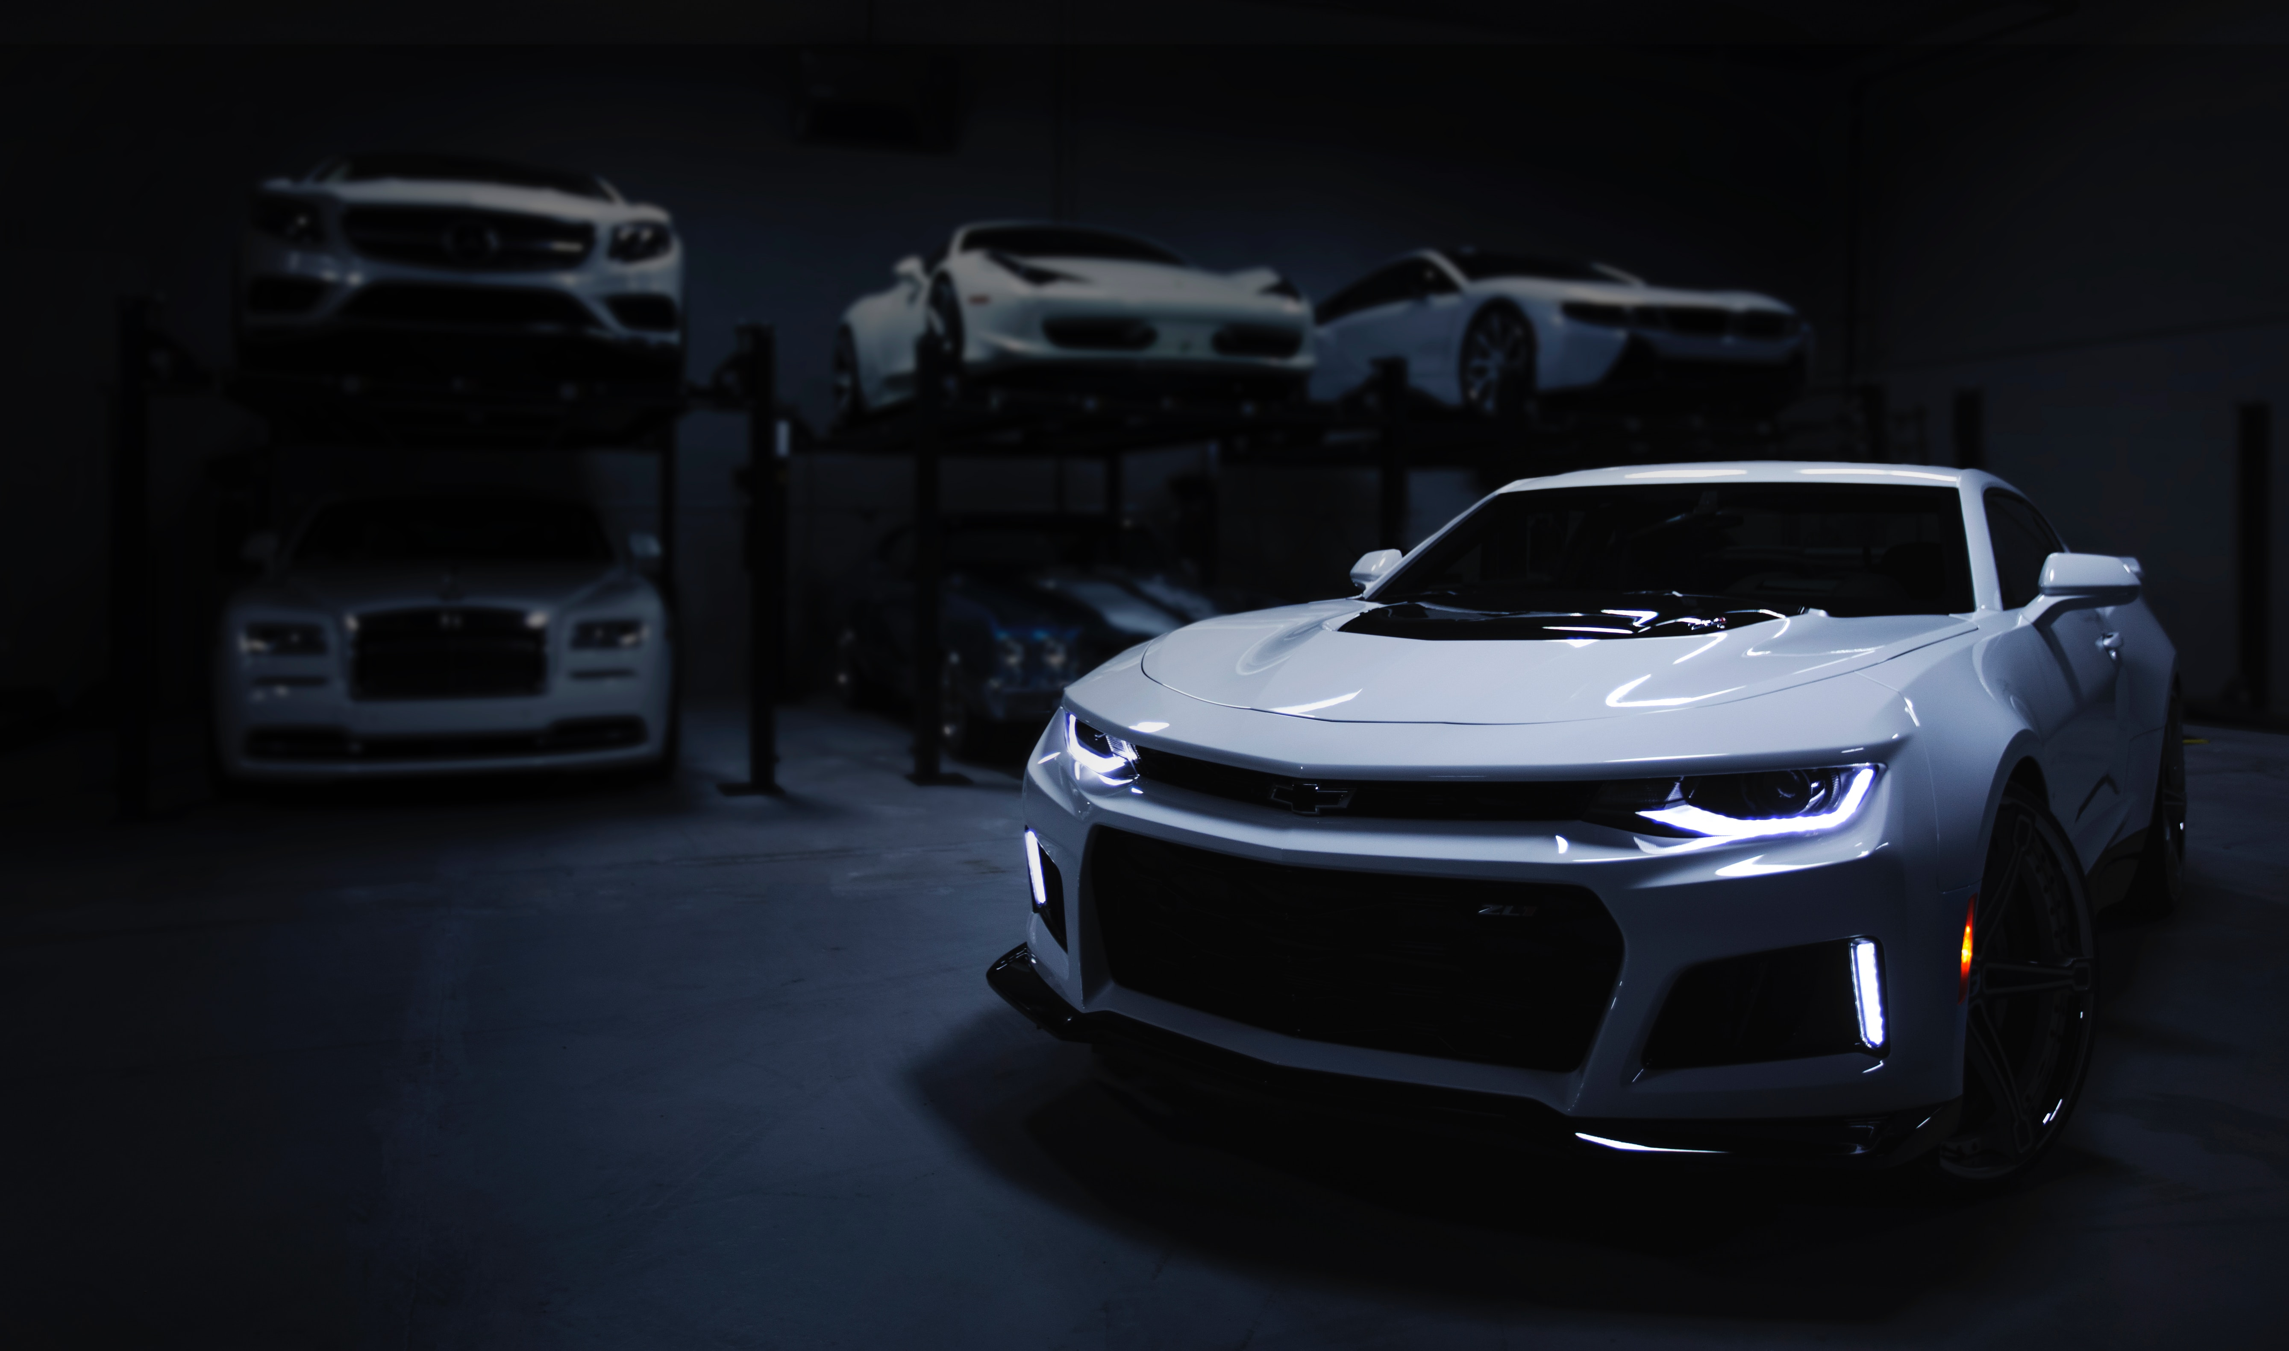
Unveiling Insights: A Comprehensive Analysis of Data

Slide 2

Introduction: Welcome to unveiling insights : A comprehensive Analysis of Data. This presentation will delve into the analysis of cars24 dataset. And I hope this give some assessment of the inventory

Slide 3

Type of Data
Data used in this project is a structured data. A structured data as name suggest is data which is structured in some manner or schema.

Slide 4
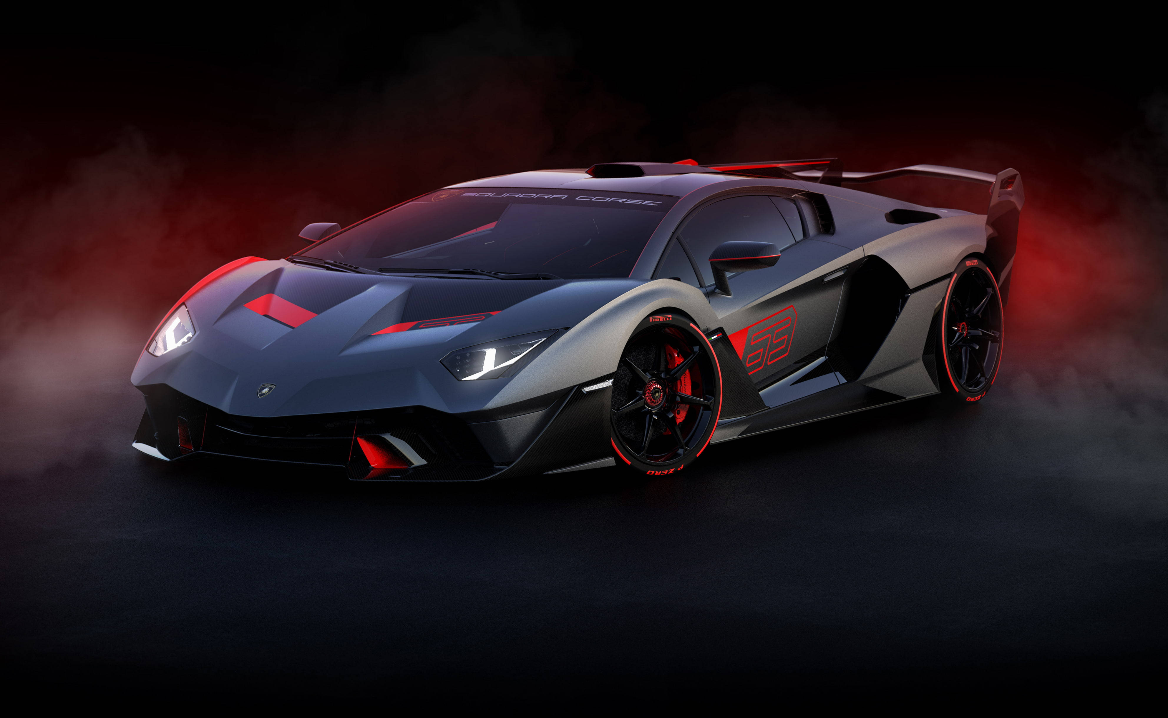

Slide 5
Contents of Data Model Name Launch Year Selling Price Km driven Fuel type Seller type Transmission : manuel/Automatic Owner Mileage Engine(cc) max power seats

Slide 6
What to Expect: This data set can help to understand dynamics ,consumer preference, and overall industry trends. Also help to analysis current inventory ,the current market trends in the buy-sell market of cars. Get better market price discovery Prioritizing which cars are easy to sell i.e. decreasing risk exposure which cars to focus on marketing.

Slide 7

Understanding cars we have
Total cars in inventory – 8128
Average price of cars is 63827.8077
Most costly car is 1 cr.

Slide 8
According to our Data : 1.Owner type and their count Owner Count of cars First owner 5289 Second owner 2105 Third owner 555 Fourth owner & above owner 174 Test drive car 5 2. Seller type and their count Individual 6766 Dealer 1126 Trustmark Dealer 236

Slide 9
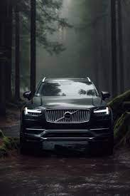
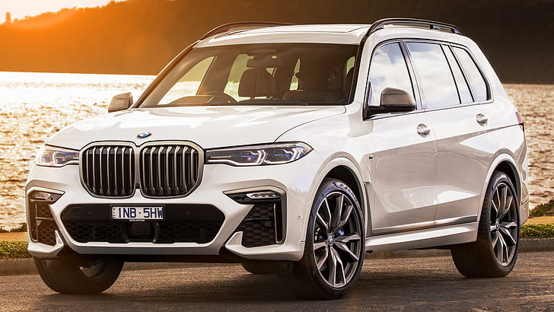
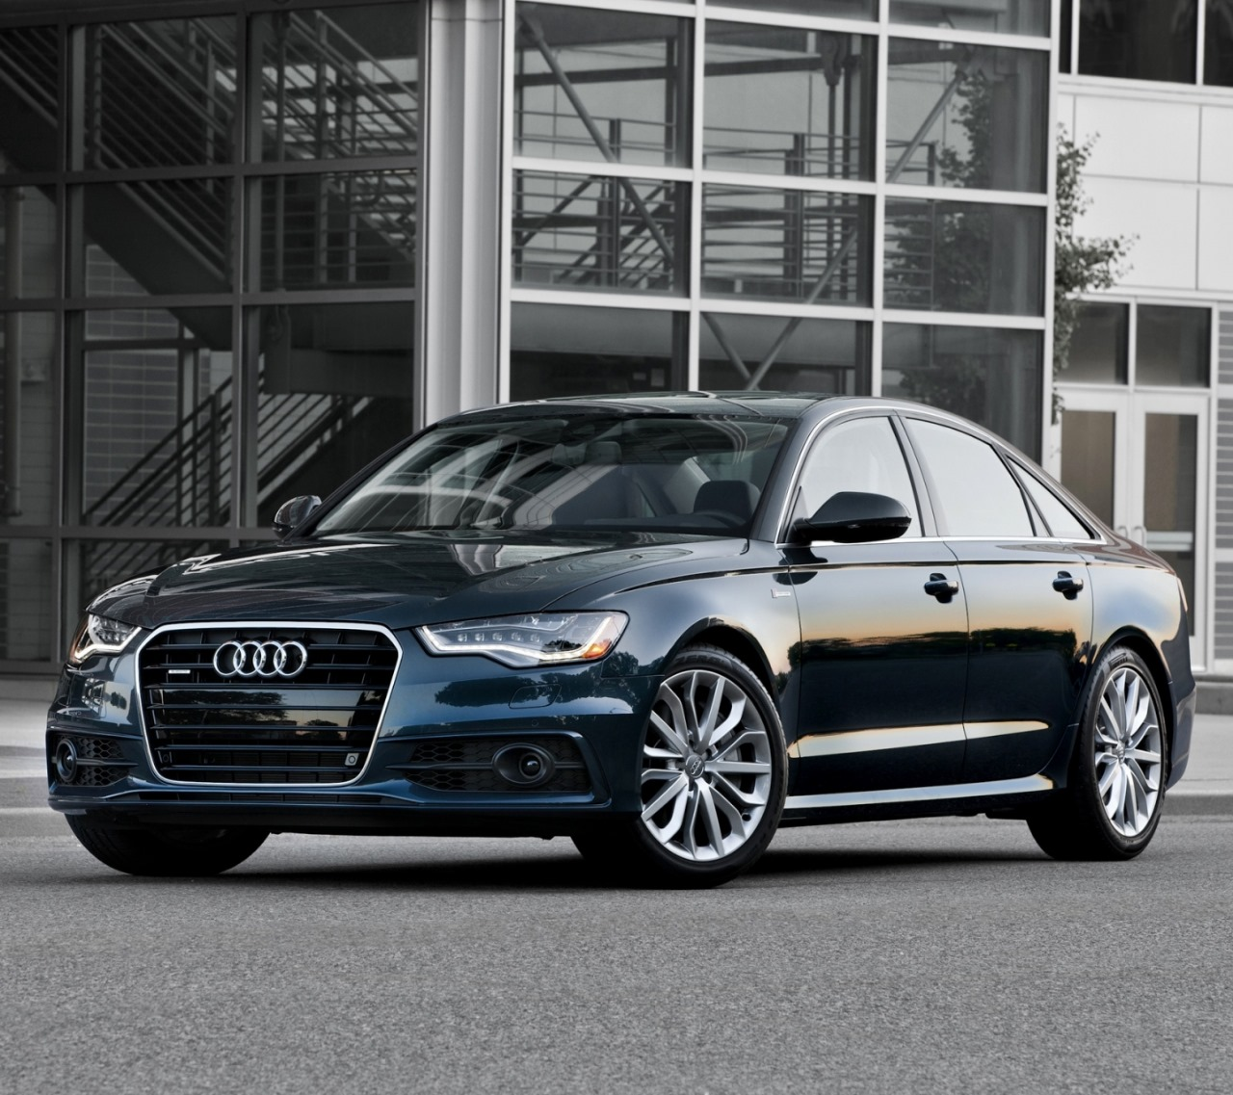
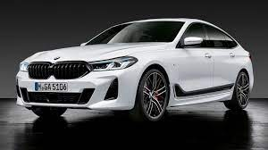
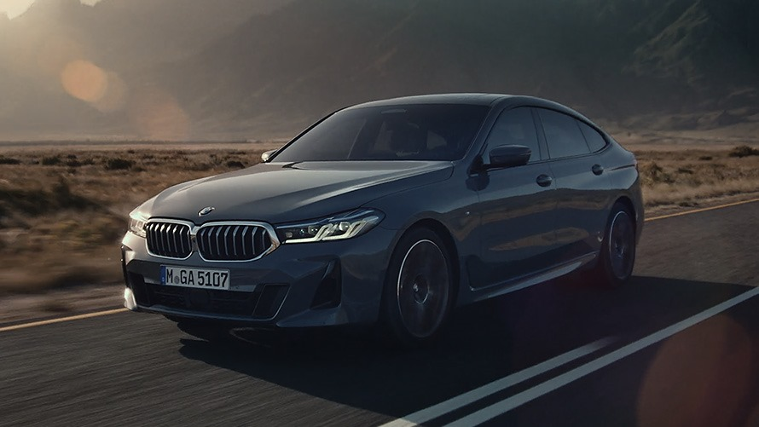
3.Most expensive 5 cars and their selling price Volvo xc90 TB Excellence BSIV BMW X7 X Drive 30d DPE Audi A6 35 TFSI Matrix 1Cr 72Lacs 65 Lacs and 23 thousand Audi A6 35 TFSI Matrix BMW 6 Series GT 630d Luxury Line 65 Lacs and 23 thousand 60 Lacs

Slide 10
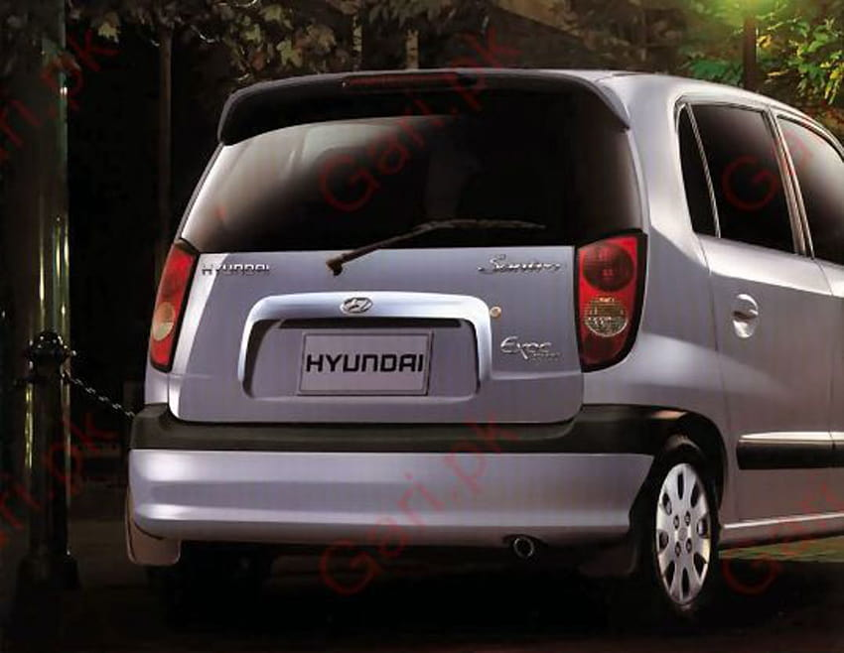
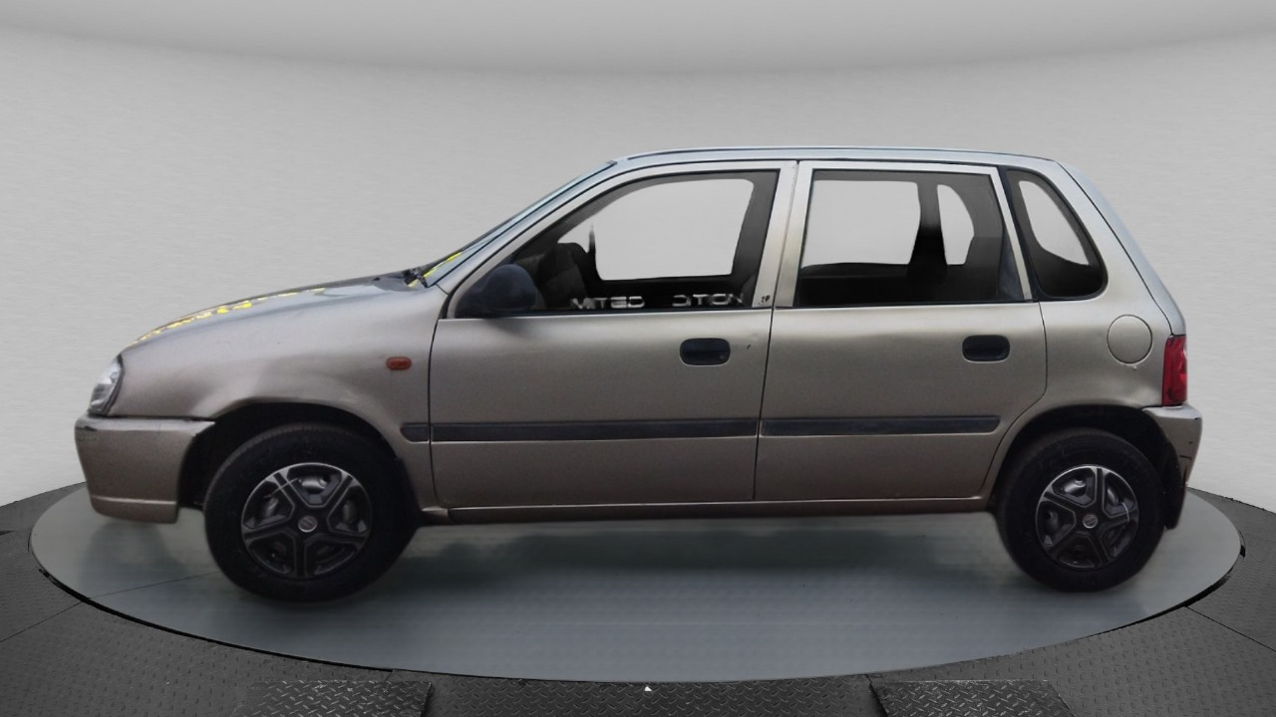
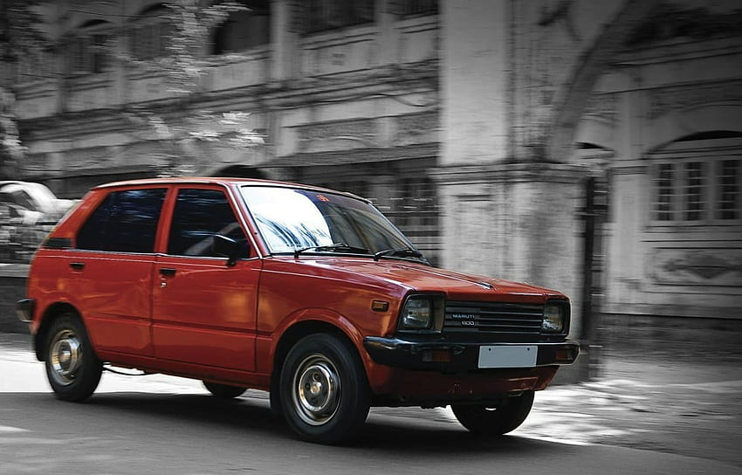
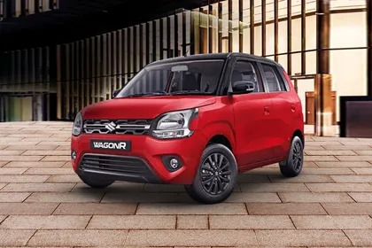
4. Least expensive 5 cars and their selling price Hyundai santro GLS I –Euro I Maruti 800 AC Maruti 800 Std Maruti Zen LXI

Slide 11
5. {5 cars with Good mileage } Volvo xc90 TB Excellence BSIV 42 Maruti alto 800 CNG LXI Optional 33.44 Maruti alto 800 CNG LXI 33.44 Maruti alto 800 CNG LXI Optional 33.44 Maruti alto 800 CNG LXI CNG 33 6. {6 cars with least mileage} Land Rover freelander 2 TD4 HSE 0 Mercedes-benz GLC 220D 4MATIC 0 Mahindra bolero pik-up CBC 1.7T 0 Mahindra bolero pik-up FB 1.7T 0 Volkswagen polo GT TSI BSIV 0

Slide 12
7.Count of cars in 5 seaters and 7 seater 5 seaters 6475 7 seaters 1120 8.Numbers of cars which run on diesel ,petrol and CNG CNG 57 Petrol 3631 diesel 4402

Slide 13
9. Years in which most car manufactured year No of cars manufactured count 2017 1018 2016 859 2018 807 2015 776 2013 670 10. Years in which least car manufactured Years No of cars manufactured count 1983 1 1991 1 1995 2 1996 3 1994 3

Slide 14
Conclusion In conclusion ,cars24 is positioned as a reliable platform for buying and selling used cars, offering transparency ,convenience, and a hassle –free experience for users with user-friendly interface ,robust inspection process, and fair prixing,cars24 aims to revolutionize the pre-owned car market ,providing customers with a trustworthy solution for their automotive needs.

